Slide 1
Lime Kiln & Hilliard Flooding

Slide 2
Low water crossing bridges replaced 2021

Slide 4
October 30, 2015

Slide 5
October 31, 2015
https://www.facebook.com/lizyakubik/videos/10208299982564191/
https://www.youtube.com/watch?v=_3YH7XAAhJw

Slide 6
November 10, 2015
Sidney Pera wrote in neighborhood facebook group: “I am not sure which commissioners were responsible when the bridge near Travis School was built. It seemed to me that they very carefully dug a lovely hole and then proceeded to lay the bridge in the hole. Why was the road not raised and culverts put under the road? Why was the bridge not built higher? Why was the second bridge, the one the flood literally removed, not raised? We have lived here since 1980. Surely, the commissioners realize we have a problem every time we have significant rain. It would seem to me that at some point the residents in this area would gain the recognition of the commissioners. It is time for us to raise our voices until the commissioners listen. We have enough people out here now to make changes that actually benefit us.”

Slide 7
November 11, 2015

Slide 8
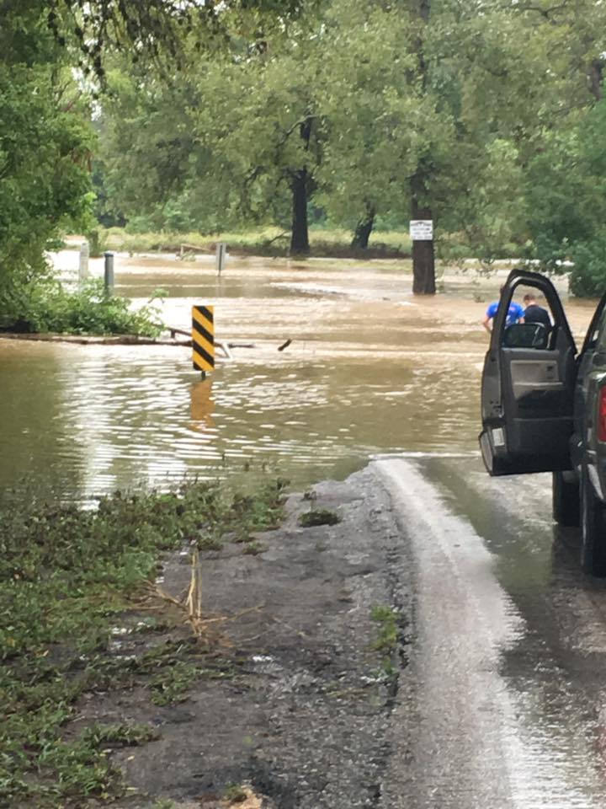
September 26, 2016

Slide 9
September 26, 2016 cont
https://www.facebook.com/lizyakubik/posts/10211141614403211

Slide 10
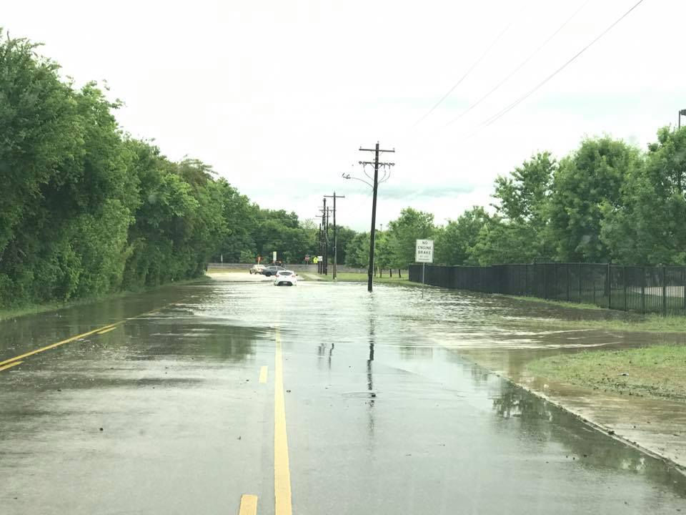
April 11, 2017
315pm

Slide 11
June 6, 2017
County Commissioners hold a meeting about replacing bridges that were damaged in Halloween 2015 flood
https://www.facebook.com/groups/1710473179167949/posts/1920110324870899/

Slide 12
March 28, 2018

Slide 13
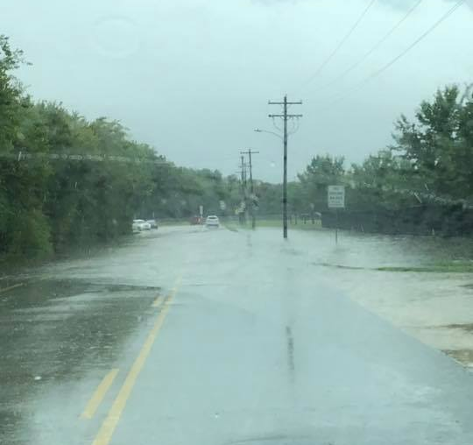
September 9, 2018

Slide 14
August-September 2021
Construction on replacement bridges at bottom of Lime Kiln are completed, but crews continue to dig out below the bridges to increase drainage

Slide 15
October 14, 2021 – Hilliard flood control dam

Slide 18
Dam locations

